Slide 1
Predicting Gas Prices From Financial Data
DS 4002 Group 7 3/26/2024
Notes:
Hello and welcome to our presentation about predicting Gas Prices based on Financial Data.

Slide 2
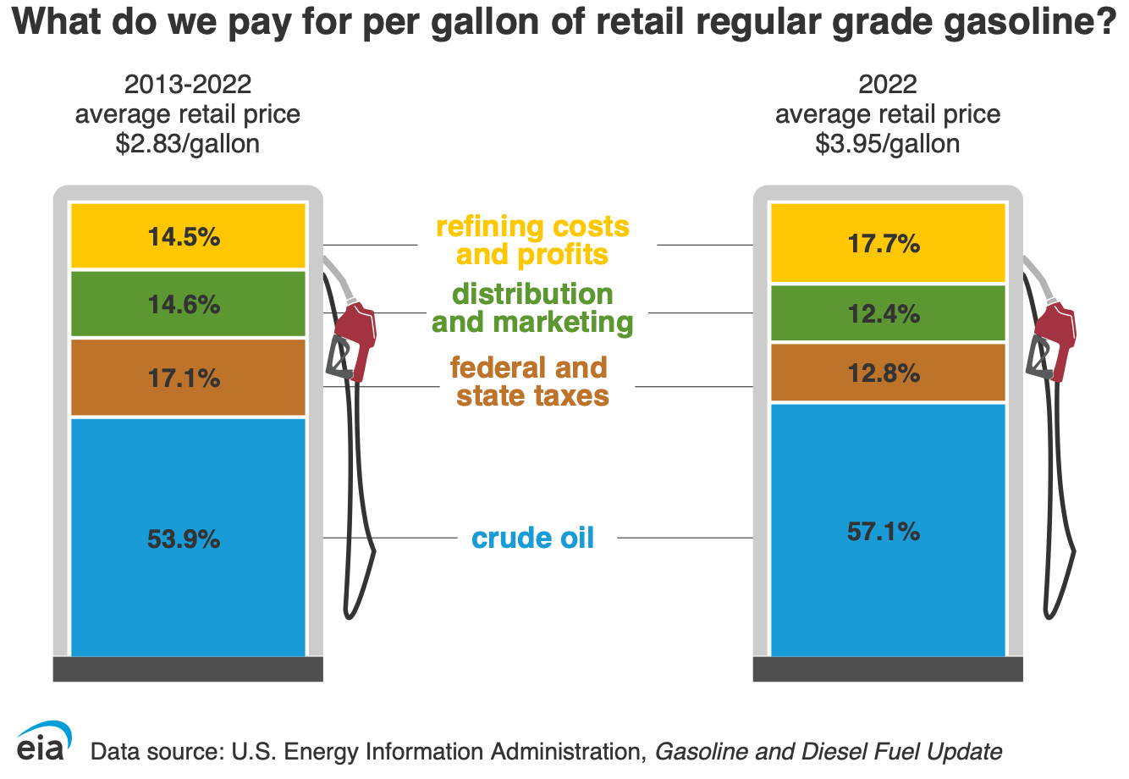
Background
Goals:
What financial statistics are best at predicting consumer gasoline prices
Can we accurately predict Gasoline prices using statistical models
Can we create a model that can predict gas prices within 50 cents of the actual price
Hypothesis:
Consumer gas prices will be predicted best by crude oil price, the energy ETFs and finally the CPI or consumer Price index, in that order
Modeling Approach:
Try a few statistical modeling techniques and select the ones with the lowest root mean squared error (RMSE)
Statistical models that were used
Gradient Boosted Machine “gbm”
Linear Model “lm”
Minimize RMSE through parameter and variable refinement
Notes:
In this project we wanted to build a statistical model that could accurately predict the price of gas for the following month. We found this interesting because many increases in gas prices are retroactively blamed on aspects of our society and we wanted to see if we could predict these proactively.
The goals of our project were to create a statistical model with a Root mean square error of less than 0.5 or 50 cents. Finally the goal of seeing what financial data was most useful in predicting gas prices based on our models was another question we wanted to answer
Our hypothesis was that we could build and accurate model and crude oil, energy etfs and finally the CPI will be the most predictive of the price
The modeling approach we took was to look at a variety of statistical models and slowly refine the models we have to produce the lowest RMSE value. These models ended up being the Gradient boosted machine model and the linear model. Finally we wanted to minimize the RMSE for what every model we did end up picking

Slide 3
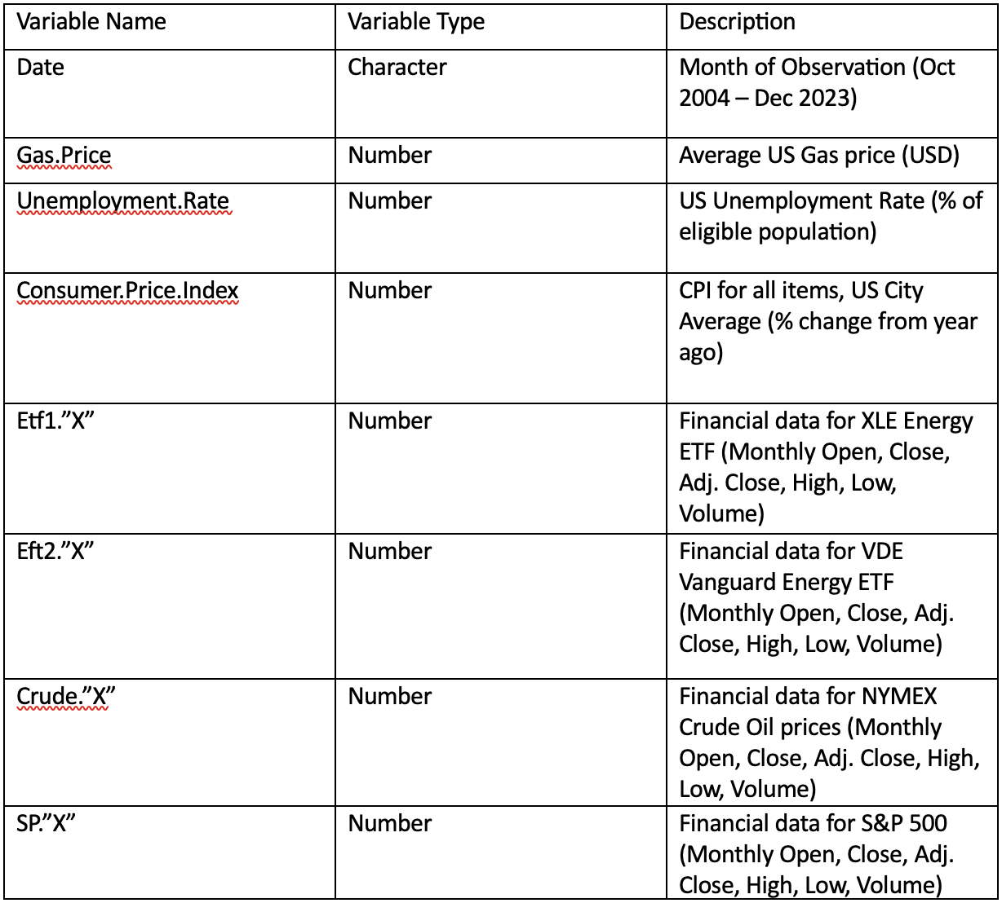
Data Acquisition
Data was collected from a number of open sources:
Monthly unemployment and CPI data gathered from bureau of labor statistics
Gas prices were found available on US energy Information Administration website
Other financial data was gathered from the Yahoo Finance API
All data is free and there are no licensing issues
Data was further coerced and cleaned into a singular data frame
The final data frame contained 26 predictive variables and ~200 months of observations
Ex. Gas.Price, Date, Crud.x, SP.x
Notes:
We acquired our data from a variety of sources. The first one was the Bureau of Labor Statistics for the United States Government- this gave us the cpi unemployment and other labor market statistics. Gas prices were gathered from the US energy Infrmation Administration website. FInancial data was gathered from the Yahoo finance API using a python file to make csv’s for each piece of financial data.
This data was then placed into a singular data frame so we could build our model. This left us with a data frame that contained 26 predictive variables and roughly 200 observations

Slide 4
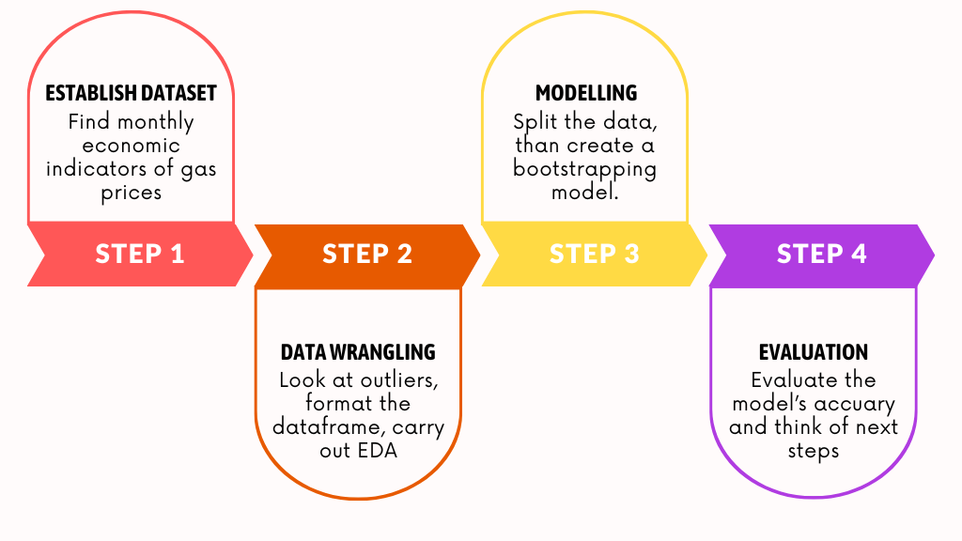
Analysis Plan
Compile data into a singular data frame
Split data into a Train and Test group
Run and train models to find the ones with the smallest RMSE value
These models ended up being the linear model and the gradient boosting machine
Fine tune model parameters and predictive variables for the model
Examine predictive nature of each Variable used for gbm model
Notes:
Our plan for the analysis was to combine the data into a singular data frame. Split the data into a train and test group. Run and train models figuring out which the best one was. Fine tune the model parameters and the predictive variables for the model. Finally examine the predictive nature of the model and the Variables used

Slide 5
Tricky Analysis Decision
What is the best time between observations to use?
Day Month Year
Different amounts of data leading to different processing times
Decided to do Monthly averages for roughly a 15 year period
What models to use?
Some models take a lot of computational energy and time to produce
What model was efficient and returned accurate gas prices?
Through trial and error the best models were eventually found
What GBM model to use?
There's a wide variety of gradient boosted machines made for different purposes
Notes:
We had a few tricky analysis decision to make. The first being what was the best time frame to use. Having less time between observations causes more data leading to more time needed to build the model. Due to the nature of these models having large data sets can cause them to take a super long time to build like days. So keeping the data set smaller but not to small is conducive to building a good model.
THe second challenge was what model to use. Some models are computationally heavy taking alot of time to produce so we wanted to find one that was efficient and still produced accurate predictions for the price of gas. The best model was eventually found using trail and error and looking at the question we wanted to answer.
Finally after selecting the models we had to select what type of gradient boosted machine to use. There are many different options depending on the data used. WE ended up using the most basic form a stochastic Gradient boosted machine model due to the low RMSE value it gave us.

Slide 6
Data Bias and Uncertainty
There is a wide range of predictive variables to choose from
The predictive variables quality and quantity can directly impact how our model functions
Statistical learning machines most important aspect is the data its trained on
Data was restricted to years with data about consumer gasoline prices
Data on the price of consumer gasoline was limited to certain years the data was actually collected
Uncertainty and variability was minimized while building the model
Repeated cross validation testing: 10 fold cross validation repeated 5 times
Notes:
When it came to data bias and Uncertainty our biggest was the fact we got to pick the predictive variables. There a tons of variables we could have picked but through background research we decided these variables were the best. OUr data was also restricted by the time range of the price of gasoline data. Finally we minimized variability and uncertainty when creating our model by doing Repeated cross validation testing to create the model.

Slide 7
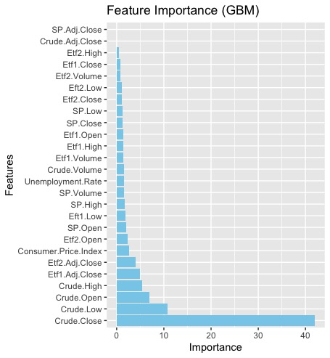
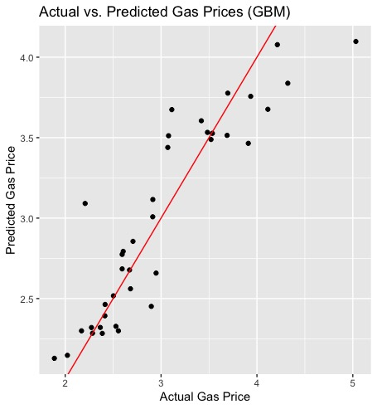
Results and Conclusions
Gradient Boosted Machine
Testing data: RMSE: 0.312
Actual model: RMSE: 0.22
Best Predictors: Crude oil, Both Energy ETFs, CPI
Notes:
The Gradient Boosted machine model had a RMSE of 0.312 or roughly 30 cents when predicting gas prices. This is about a 10% erro

Slide 8
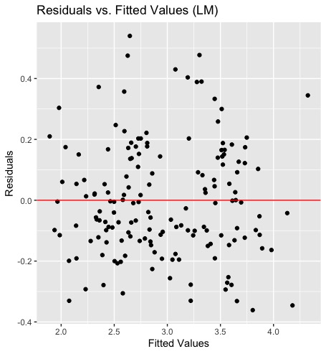
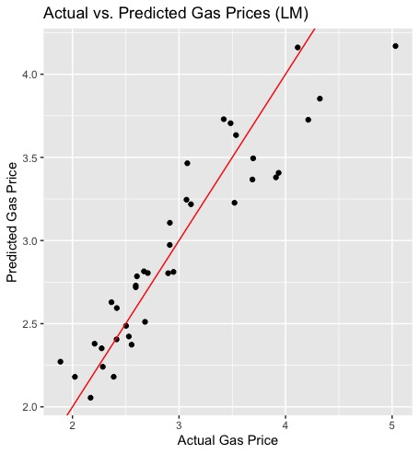
Results and Conclusions
Linear Model
Test Data: RMSE: 0.298 R-Squared: 0.87
Actual Model: RMSE: 0.23 R-Squared: 0.90
The residuals are randomly fitted around 0 meaning a linear model is a good fit
Residuals
Notes:
Make the graphs more clear

Slide 9
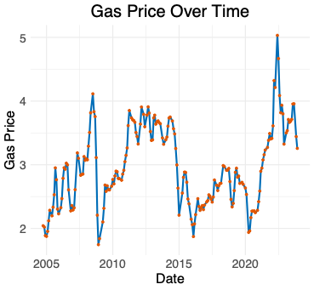
Next Steps
Make the model more accurate by decreasing the time range between observations
Makes the model more useful over shorter periods of time
Include better predictors for gas prices.
Select better variables
Increase our predictive range
Create models that can predict gas prices 3 months 6 months and 12 months in advanced
Notes:
Three directions we

Slide 10
References
Factors Affecting Gasoline Prices - U.S. Energy Information Administration (EIA). https://www.eia.gov/energyexplained/gasoline/factors-affecting-gasoline-prices.php. Accessed 24 Mar. 2024. Federal Reserve Economic Data | FRED | St. Louis Fed. https://fred.stlouisfed.org/. Accessed 24 Mar. 2024. Machine Learning Mastery- A gentle introduction to gradient Boosted Algorithms for Machine learning. https://machinelearningmastery.com/gentle-introduction-gradient-boosting-algorithm-machine-learning/. Accessed 15 Mar. 2024. Machine Learning Mastery- A gentle introduction to K-fold Cross-Validation. https://machinelearningmastery.com/k-fold-cross-validation/. Accessed 15 Mar. 2024 U.S. Regular All Formulations Retail Gasoline Prices (Dollars per Gallon). https://www.eia.gov/dnav/pet/hist/LeafHandler.ashx?n=pet&s=emm_epmr_pte_nus_dpg&f=m. Accessed 24 Mar. 2024. Yahoo Finance - Stock Market Live, Quotes, Business & Finance News. https://finance.yahoo.com/. Accessed 24 Mar. 2024.
Data Sources:
https://www.eia.gov/petroleum/gasdiesel/
https://fred.stlouisfed.org/series/UNRATE
https://fred.stlouisfed.org/series/CPIAUCSL

